Slide 1
MiFID / MiFIR - Investor Protection
Jacob Gertel, April 2016

Slide 2
Introduction
Investor Protection - Highlights
Challenges to the Financial Industry

Slide 3
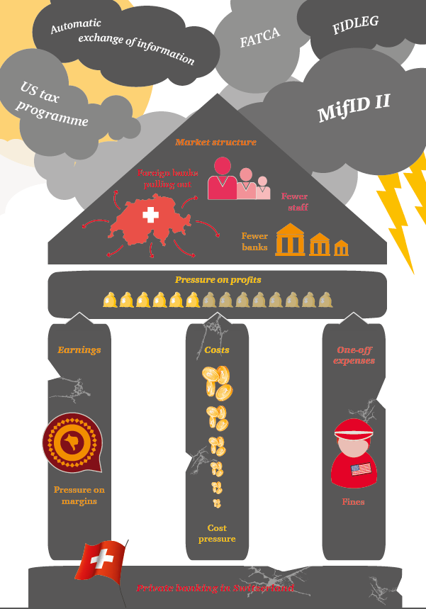

Swiss Private Banking Business Environment – PwC Study
COMPLIANCE TEAM
Source: http://www.pwc.ch/user_content/editor/files/publ_bank/pwc_private_banking_switzerland_from_yesterday_to_the_day_after_tomorrow.pdf
Page3

Slide 4












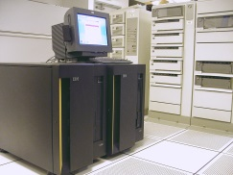



Daily activities of a compliance officer at small private bank:
Board of Directors / Management
Private Banking Dept.
Laws / Regulations / Directives
Audit – internal & external
Tax Dept.
Regulatory Investigations
IT
Sec./ Money Transfer Dept.
Credit Dept.
Marketing Dept.
Trading Dept.
HR
Page4
Page4

Slide 5










MiFID II - Regulatory Framework
MiFID II -requirements &
Regulatory Landscape
Transparency
Microstructural Issues
Data Publication
and Access
Requirements Applying to Trading Venues
Investor Protection
(Best Execution)
Post-Trade Issues
Market Data Reporting
Commodity
Derivatives
UCITS
AIFMD
PRIIP / KIID
EMIR
MAR
FINFRAG
FIDLEG
SEC Rules
HK Rules
SG Rules
Notes:
MiFID II and MiFIR are an extension of the existing MiFID/MiFIR. The directive goal is to “raise the bar” in the EU financial markets in the following areas:
transparency, microstructural issues, data publication and access, requirements applying to trading venues, commodity derivatives, market data reporting, post trade issues and investor protection (best execution).
The Directives /Regulations will go into practice on January 2018. The directives are influencing also non-EU countries, like Switzerland, that is in the legislation process of FinSA - Financial Services Act (FIDLEG).
Transparency – the overall and most important goal of the directive, pre-/post-trade transparency
Micro-structural Issues – transparency concerning organizational standards related to algo-trading, disclosure of fee structure related to trading venues, tick-size for shares/depositary receipts/funds, trading notifications
Data Publication and Access – organizational requirements concerning data reporting services providers, e.g. Approved Reporting Mechanism (ARM), Approved Publication Arrangement (APA), Consolidated Tape Provider (CTP)
Requirements Applying on and to Trading Venues – admission, suspension and removal of financial instruments from trading
Commodity Derivatives – methodology for calculation and the application of position limits for commodity derivatives traded on trading venues and OTC
Market Data Reporting – reporting obligations, obligation to supply financial instrument reference data, data relating to orders in financial instruments
Post-Trade Issues – obligation to clear derivatives traded on regulated markets and timing of acceptance for clearing
Best Execution – quality of the execution

Slide 6
Investor Protection - Highlights (1/5)
MiFID II / MiFIR goals are to ensure within the EU the transparency in the financial market as well as to raise the bar concerning «investor protection».
The «investor protection» is a broad requirements and ESMA is committed to ensure that:
Firms treat their customers in a fair and transparent way and put customers interests at the center of their business models and corporate culture;
Investors are provided with clear and relevant information; and
Investors are provided with products that match their needs and investment objectives.
Source: https://www.esma.europa.eu/regulation/mifid-ii-and-investor-protection
Page

Slide 7
Directives and Amendments Highlights (2/5)
Firms treat their customers in a fair and transparent way and put customers interests at the center of their business models and corporate culture:
MAR – Market Abuse Directive / remunerations
Guidelines – Knowledge and competence
Putting in place adequate procedures and policies
On-going monitoring of regulatory developments and training
Following cross-border regulations – third country regime
Page7

Slide 8
Directives and Amendments Highlights (3/5)
Investors are provided with clear and relevant information :
Pre trade information – KIDs for PRIIPs
Best Execution
Complex / non-complex instruments
Tax implications
Costs transparency
Page8

Slide 9


Directives and Amendments Highlights (4/5)
MiFID II Investor Protection – Service Model for Retail Clients
Advisory
Execution-Only
Complex Instruments
Non-complex Instruments
Suitability Test
Appropriateness Test
No Test
Knowledge and
Experience
Ability to bear
financial risks
Investment
Objectives
Page 9

Slide 10
Directives and Amendments Highlights (5/5)
Investors are provided with products that match their needs and investment objectives :
Suitability checks
Solid KYC – verifying “risk-apetite” of investors – wit on-going monitoring
Investor classifications – retail, professional (varies from jurisdiction to jurisdiction)
Putting in place adequate controls and monitoring – either from regulators as well as within the firms
Page10

Slide 11
Challenges to the Financial Industry
The implementation of MiFID II is challenging to the financial industry in the following aspects :
Short implementation time - comprehensive regulatory framework covering all organization units – FO, MO, BO
Regulatory “Tsunami” – implementation parallel to MiFID II “local flavors”, CRS (AIA), Section 871(m), Basel III, AML new guidelines, etc.
Highly costs – IT costs, staff (compliance), Audit costs
Ensuring updates of policies and guidelines together with adequate controls and training to staff
Regulators have “zero tolerance”
Page11

Slide 12
MiFID II Target Market
Companies active in the areas of investment advisory
Geographically MiFID II affects these companies globally- obviously within the EU but, also in Switzerland (FIDLEG harmonization with MiFID) and elsewhere (due to the “Third Countries” guidelines)
FO – Advisory Process
MO
BO
Crossborder /
Client Onboarding
Wealth
Planning
Client
Profiling
Investment
Strategy /
Tax Planning
Portfolio
Construction
Portfolio
Monitoring
Pre-Trade
Suitability
Regulatory
Doc Services
Portfolio
Adjustment
Product Governance
PRIIP
Generation
Pre-Trade Transparency
Post-Trade
Transparency
Transaction
Reporting
SIX Content
(completeness, correctness, coherence)
MiFID II
Page

Slide 13
Main Regulations / Directives - overview
Regulation | What is all about | Link
ESMA MiFID II / MiFIR Final report | Final Regulations | https://www.esma.europa.eu/sites/default/files/library/2015/11/2015-esma-1464_-_final_report_-_draft_rts_and_its_on_mifid_ii_and_mifir.pdf
ESMA MiFID II / MiFIR Annex I, ITS | Technical standards | https://www.esma.europa.eu/sites/default/files/library/2015/11/2015-esma-1464_annex_i_-_draft_rts_and_its_on_mifid_ii_and_mifir.pdf
Final report – guidelines on complex debt instruments and structured deposits | Providing the classification of complex / non-complex instruments | https://www.esma.europa.eu/sites/default/files/library/2015-1783_-_final_report_on_complex_debt_instruments_and_structured_deposits.pdf FAQ: http://europa.eu/rapid/press-release_MEMO-14-305_de.htm?locale=en Opinion: https://www.esma.europa.eu/sites/default/files/library/2015/11/ipisc_complex_products_-_opinion_20140105.pdf
PRIIP | PRIIP Final Regulation | https://www.esma.europa.eu/sites/default/files/library/jc_2016_21_final_draft_rts_priips_kid_report.pdf
Page13

Slide 14
Thank you for your attention

